Slide 1
Meeting 10 Heart Disease or Heart Health?
City of Ventura
Wellness Program 2014 A
w/ Dr. Kristofer Young

Slide 2
Garden Color Health
Heart Disease or Heart Health?

Slide 3
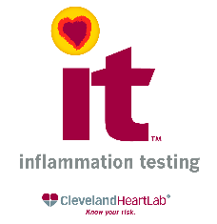
Inflammation
Your Blood Work; get to know it
“The risk of developing heart disease has traditionally been assessed using a standard lipid panel. However, about 50% of heart attacks and strokes occur in people with 'normal' cholesterol. Thus, there are a high percentage of people at risk who are presumed healthy. While we believe it is essential to know your cholesterol levels, what actually causes heart attack and strokes is inflammation, specifically vulnerable plaque related to increased inflammation.

Slide 4
Heart Disease or Heart Health?
Heart Disease or Heart Health?
Number of deaths for leading causes of death
CDC 2009 - http://www.cdc.gov/nchs/fastats/lcod.htm
Heart disease: 599,413
Cancer: 567,628
Chronic lower respiratory diseases: 137,353
Stroke (cerebrovascular diseases): 128,842
Accidents (unintentional injuries): 118,021
Alzheimer's disease: 79,003
Diabetes: 68,705
Influenza and Pneumonia: 53,692
Nephritis, nephrotic syndrome, and nephrosis: 48,935
Intentional self-harm (suicide): 36,909

Slide 5
Heart Disease or Heart Health?
Heart Disease or Heart Health?
One way to look at these data, is that the heart is the number one killer.
Another way to look at them is that the heart is the part of our body that has the greatest need for healthy conditions.

Slide 6
Heart Disease or Heart Health?
Heart Disease or Heart Health?
Does heart disease “run” in your family?
Does heart disease worry you, for yourself, or for someone close to you?
Do you believe that heart disease is primarily genetically determined?

Slide 7
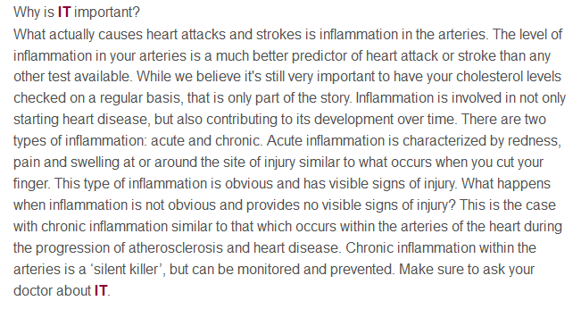
Inflammation
Heart Disease or Heart Health?
The basis of heart disease is inflammation

Slide 8
Inflammation
Heart Disease or Heart Health?
What are some of the most important causes of inflammation?
sugar/starch stress lack of exercise
fat cells low vitamin D intestinal dysbiosis
low EPA-DHA low antioxidants
food allergy leaky gut toxins
lack of meaningful human relationships

Slide 9
Heart Disease or Heart Health?
Heart Disease or Heart Health?
What tests best tell us about our risk for heart disease?

Slide 10
Laboratory Test Variations
Heart Disease or Heart Health?
Quest Diagnostics
Cardiac Risk Assessment
Lipid profile;
hs-CRP;
Lp(a);
Lp-PLA2

Slide 11
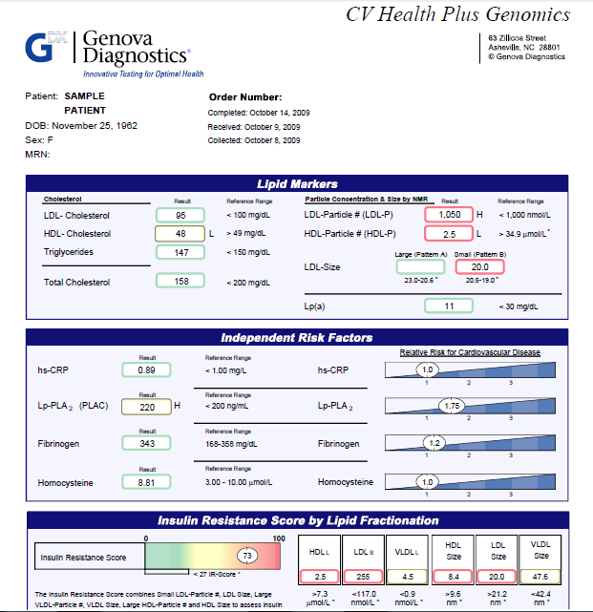

Slide 12
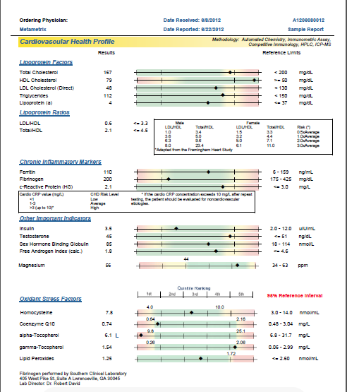

Slide 13
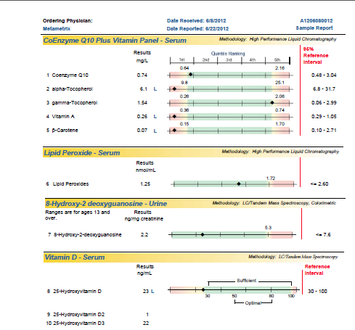

Slide 14
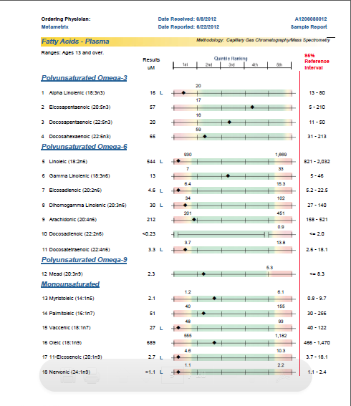

Slide 15
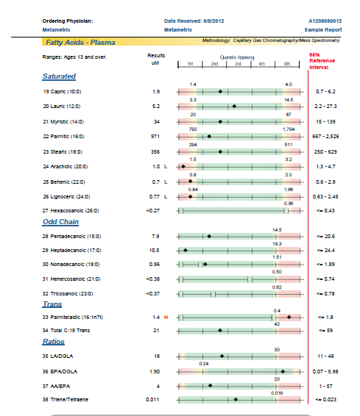

Slide 16
Laboratory Test Variations
Heart Disease or Heart Health?

Slide 17
Laboratory Test Variations
Heart Disease or Heart Health?

Slide 18
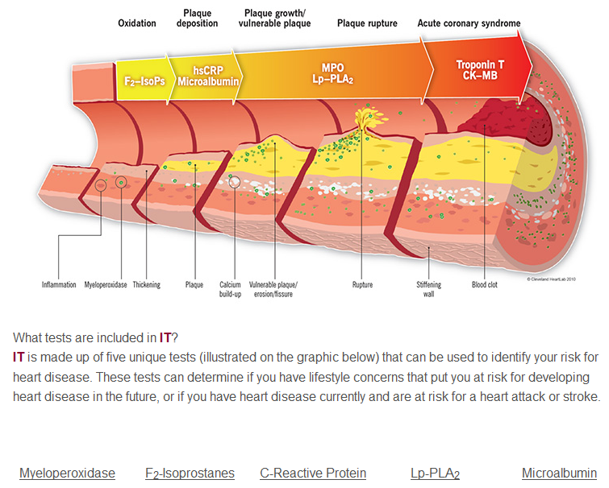

Slide 19
Heart Disease or Heart Health?
Heart Disease or Heart Health?
Dr. Mark Hyman
1. Total cholesterol, HDL cholesterol, LDL cholesterol, and triglycerides.
2. NMR Lipid Profile. This looks at your cholesterol under an MRI scan to assess the size of the particles, which can determine your cardiovascular risk.
3. Cardio C-reactive protein. This is a marker of inflammation in the body that is essential to understand in the context of overall risk.
4. Homocysteine. Your homocysteine measures your folate status.
5. Lipid peroxides or TBARS test, which looks at the amount of oxidized or rancid fat. Indicates whether or not you have oxidized cholesterol.
6. Fibrinogen, which is another test looking at clotting in the blood.
7. Lipoprotein (a), which is another factor that can promote the risk of heart disease, often in men.
8. Genes or SNPs may also be useful in terms of assessing your situation. Apo E genes and the cholesterol ester transfer protein gene. The MTHFR gene, which regulates homocysteine is also important and may be part of an overall workup.
9. If you are concerned that you have cardiovascular disease, a high-speed CT or (EBT) scan of the heart may be helpful to assess overall plaque burden and calcium score.

Slide 20
Heart Disease or Heart Health?
Heart Disease or Heart Health?
What does YOUR doctor believe are the most important tests to assess your risk for heart disease?
I encourage you to contact your doctor’s office and ask, and report back to us.

Slide 21
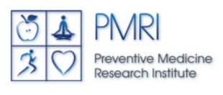
Heart Disease or Heart Health?
Heart Disease or Heart Health?
Dean Ornish, MD and his

Slide 22
Heart Disease or Heart Health?
Heart Disease or Heart Health?

Slide 23
Heart Disease or Heart Health?
Heart Disease or Heart Health?

Slide 24
Notes:
Video from Alldata Satellite\IFM\Contacts\Ornish Dean\Ornish Spectrum Introduction_ 3 minute nutshell

Slide 25
Heart Disease or Heart Health?
Heart Disease or Heart Health?
May 2013
69 year-old new patient requests 2nd opinion from Dr. Young on whether to have 3rd stent placed in coronary artery
Dr. Dean Ornish’s program had never been mentioned, much less recommended

Slide 26
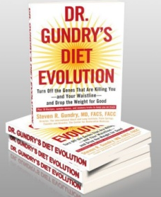
Heart Disease or Heart Health?
Heart Disease or Heart Health?
Dr. Steven Gundry

Slide 27
Heart Disease or Heart Health?
Heart Disease or Heart Health?

Slide 28
Heart Disease or Heart Health?
Heart Disease or Heart Health?
Dr. Gundry’s Approach
Lots of greens
No, or low starch
No sugar
Initially high and then low protein
Nutritional supplements
Moderate exercise

Slide 29
Heart Disease or Heart Health?
Heart Disease or Heart Health?
What does YOUR doctor believe are the most important things you can do to reduce your risk of heart disease?
What does she advise for reversing your heart disease?

Slide 31
Heart Disease or Heart Health?
Heart Disease or Heart Health?
How to stack the deck for your heart
Love & Safety
Rest & Exercise
High veggies, low protein, low starch & sugar
Low food allergens and high food variety
Vitamin D, fish oil, magnesium, antioxidants
Some rational testing
A real, written health plan

Slide 32
And to Close
Heart Disease or Heart Health?
Please write in 20 or fewer words, what, if anything, was important to you from this meeting, share your words with us, and give your paper to me before you leave.

Slide 33
Start young: my grandson, Zion, working with me in my organic vegetable garden.

