Slide 1
Meeting 6 Your Blood Work; get to know it
City of Ventura
Wellness Program 2014 A
w/ Dr. Kristofer Young

Slide 2
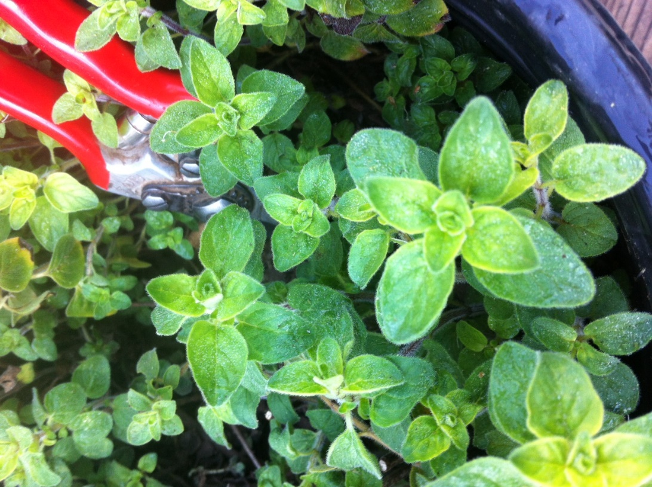
First things first
One minute of relaxed, conscious breathing with oregano
30-second check-in

Slide 3
Where are we today?
Your Blood Work; get to know it
Is your blood work important?
Do you get and keep copies of all your blood tests?
Do you understand the results of your blood tests?
Do you track the improvement or worsening of your results?

Slide 4
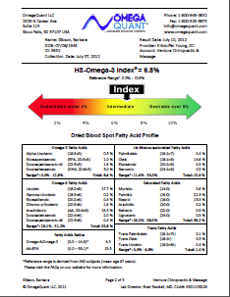
Your Blood Work; get to know it
What’s
the
disconnect?

Slide 5
Why do we do blood work?
Your Blood Work; get to know it
Warn of imbalance or disease
Track imbalance or disease
Track improvement
Confirm balance, sufficiency, health (not enough of this)

Slide 6
Reference Ranges
Your Blood Work; get to know it
Don’t rely on the results without asking a few questions
Lack of agreement – Vitamin D 30-100 or 50-100?
Don’t make sense – glucose – WebMD <110 mg/dL, American Diabetes Assn. says 70-99, but incidence of stroke increases above 83 mg/dL
If your numbers are within the “normal” range is everything OK? Is “normal” healthy?
Learn about healthy ranges by finding believable sources and asking questions.

Slide 7
A Few Basic, Important Tests
Your Blood Work; get to know it
Glucose
Cholesterol
Inflammation
Vitamin D
CBC
Omega 3 fatty acids

Slide 8
Glucose = Sugar
Your Blood Work; get to know it
Fasting glucose – limited value
Insulin
Glucose tolerance test w/ insulin
Hemoglobin A1c

Slide 9
Cholesterol
Your Blood Work; get to know it
Cholesterol - “old school” – LDL, HDL, total cholesterol, and triglycerides
The routine cholesterol test detects only about 40% of people at risk of coronary heart disease. (atherotech.com)
Expanded cholesterol panel – subclasses, particle number, and particle size

Slide 10
Inflammation
Your Blood Work; get to know it
High-sensitivity CRP (hs-CRP)
Erythrocyte Sedimentation Rate (ESR)

Slide 11
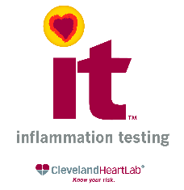
Inflammation
Your Blood Work; get to know it
“The risk of developing heart disease has traditionally been assessed using a standard lipid panel. However, about 50% of heart attacks and strokes occur in people with 'normal' cholesterol. Thus, there are a high percentage of people at risk who are presumed healthy. While we believe it is essential to know your cholesterol levels, what actually causes heart attack and strokes is inflammation, specifically vulnerable plaque related to increased inflammation.

Slide 12
Inflammation
Your Blood Work; get to know it
Myeloperoxidase (MPO)
Lp-PLA2 (The PLAC Test)
High-Sensitivity CRP
Urinary Microalbumin/Creatinine ratio
F2-Isoprostanes/Creatinine ratio

Slide 13
Vitamin D
Your Blood Work; get to know it
25-hydroxy-vitamin D
30-100 mg/mL or 50-100?
Healthy levels reduce all chronic degenerative disease
The Vitamin D Council

Slide 14
Complete Blood Count (CBC)
Your Blood Work; get to know it
RBC, WBC and platelets
Help diagnose various conditions, such as anemia, infection, inflammation, bleeding disorder or leukemia, to name just a few
Abnormalities can be due to autoimmune diseases

Slide 15
Omega 3’s
Your Blood Work; get to know it

Slide 16
Omega 3’s
Your Blood Work; get to know it

Slide 17
Omega 3’s
Your Blood Work; get to know it

Slide 18
Omega 3’s
Your Blood Work; get to know it
The risk for sudden cardiac death is reduced by up to 90% in individuals with the highest HS-Omega-3 Index®, and there is growing evidence for an association between omega-3 biostatus and other conditions such as cellular aging, dry eye, macular degeneration, dementia, depression, joint health, etc. Most Americans do not get enough omega-3′s from their diets, and differences in age, weight, sex, diet, lifestyle habits, metabolism, and absorption make it impossible to accurately predict anyone’s omega-3 status. The only way to know for sure is to measure the HS-Omega-3 Index®

Slide 19
Omega 3’s
Your Blood Work; get to know it
Contact:
http://www.omegaquant.com/

Slide 20
What’s a Person to Do?
Your Blood Work; get to know it
Start tracking your own lab test results
Do you really think that even a caring doctor can track all of these, and do you justice?
Simple form – excel file – chart or graph

Slide 21
And to Close
Your Blood Work; get to know it
Please write in 20 or fewer words, what, if anything, was important to you from this talk, and then share them with us! ☺

Slide 22
Start young: my grandson, Zion, working with me in my organic vegetable garden.

